Slide 1
By Manasa Giddalapati
DIGITAL BOOKS

Slide 2
Abstract
Digital Books is the replacement for old library Management systems
which are ordinary and depend on manual working for recording Books, readers, authors and payment Information .
It is a new, self-contained project.

Slide 3
Existing System
In the available Online Library Management System, librarian maintains the details of each book on the registers
While they need to spend an extra hour to maintain the records of books.
For a student who wants to know about a book in the library need to search the entire book section.
Student needs to check the status of the book means the last date of book, how many books has issued.

Slide 4
Limitations
More time Consuming
No option for author to add books.
Payment option not available
Not flexible
Requires more Manpower

Slide 5
Proposed System
Digital Books is an application which refers to library systems which are generally small or medium in size.
It is used by author to manage the library using a computerized system where he/she can add new books, videos and Page sources.
Books and reader maintenance modules are also included in this system which would keep track of the reader using the website and also a detailed description about the books a library contains.

Slide 6
Advantages
Less Time Consuming
More Flexible
Author can add books and block or unblock book
Reader can search books
Reader can buy books and read books online

Slide 7
Registration Page
MODULES
.
03
02
01
Payment
Reader
.
Author

Slide 8
Author
Author can create account
Author can login
Author can create book
Author can edit/block/unblock book

Slide 9
Reader
Reader can search
Reader can buy book
Reader can find all purchased books
Reader can read book

Slide 10
Payment
Reader can download invoice
Reader can find purchased book by payment Id
Reader can ask for refund within 24 hours of payment

Slide 11
Tools Used
Windows OS
Azure Cloud(for Deployment)
Git
Visual Studio Code
Visual Studio 2022
SQL Server
Angular , Bootstrap
.Net Core Web API,C#

Slide 12
USER FLOW CHART

Slide 13
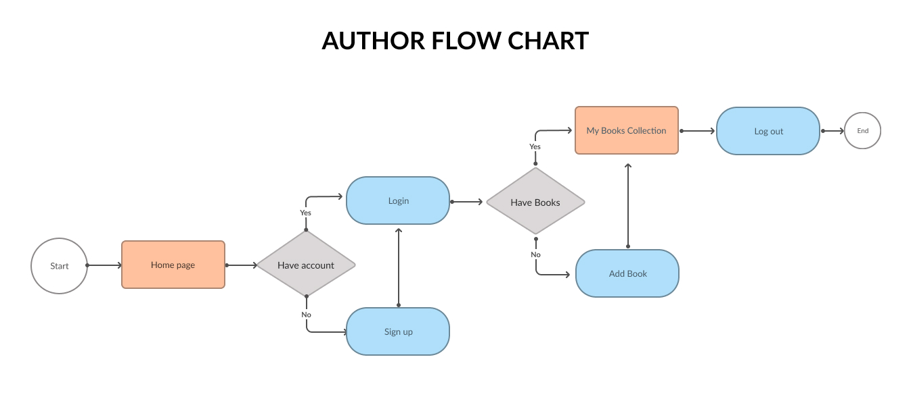

Slide 14
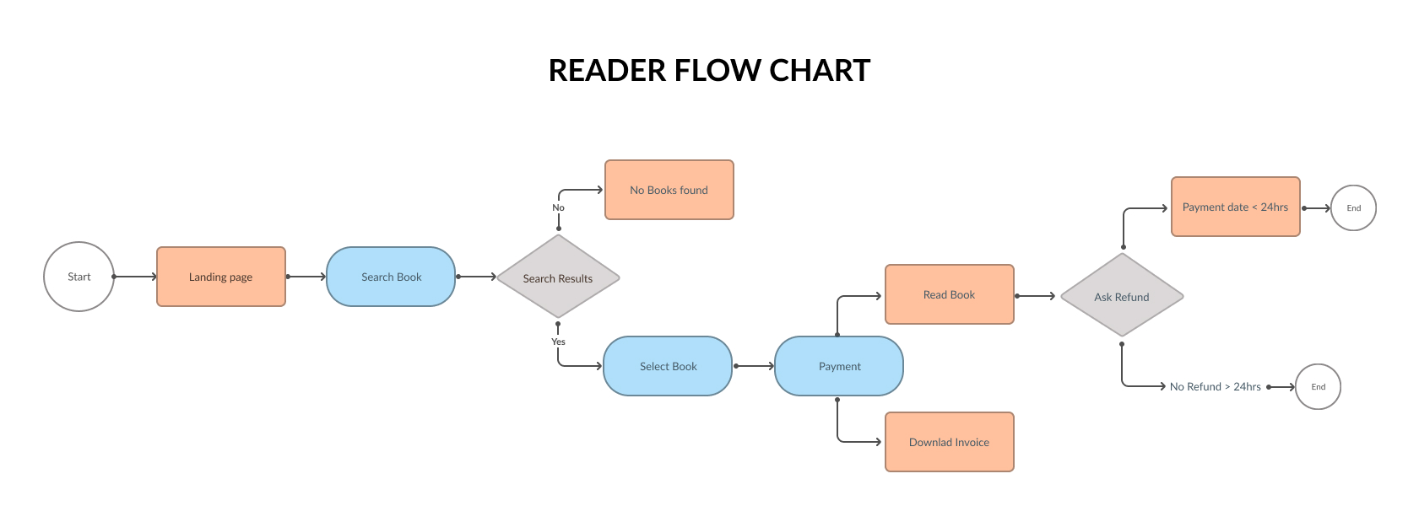

Slide 15
OUTPUT SCREENS

Slide 16
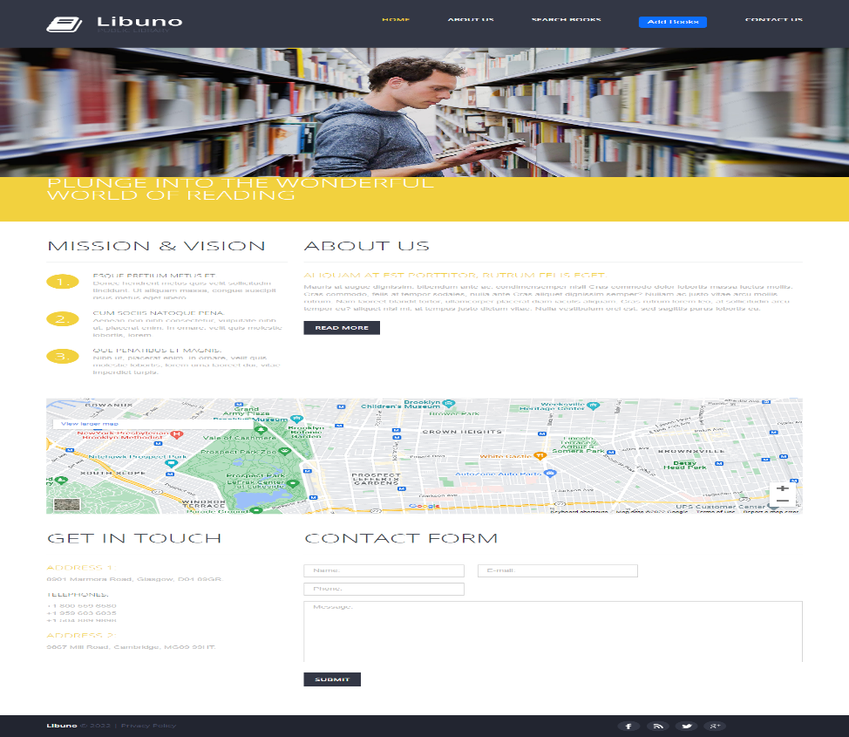
Home Page

Slide 17
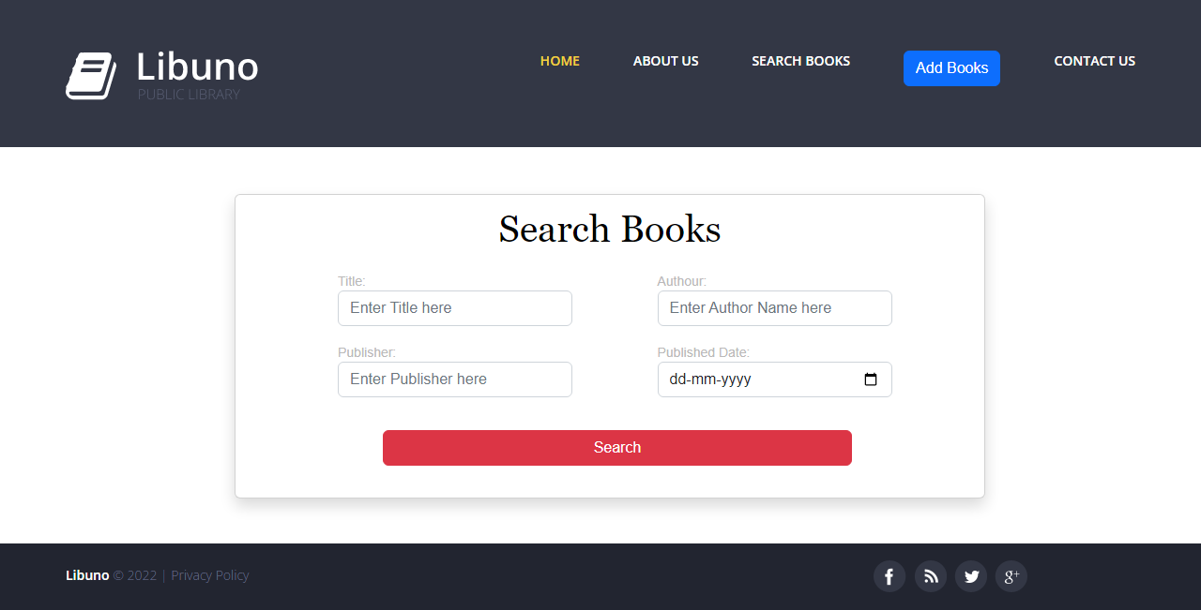
Search Book Page

Slide 18
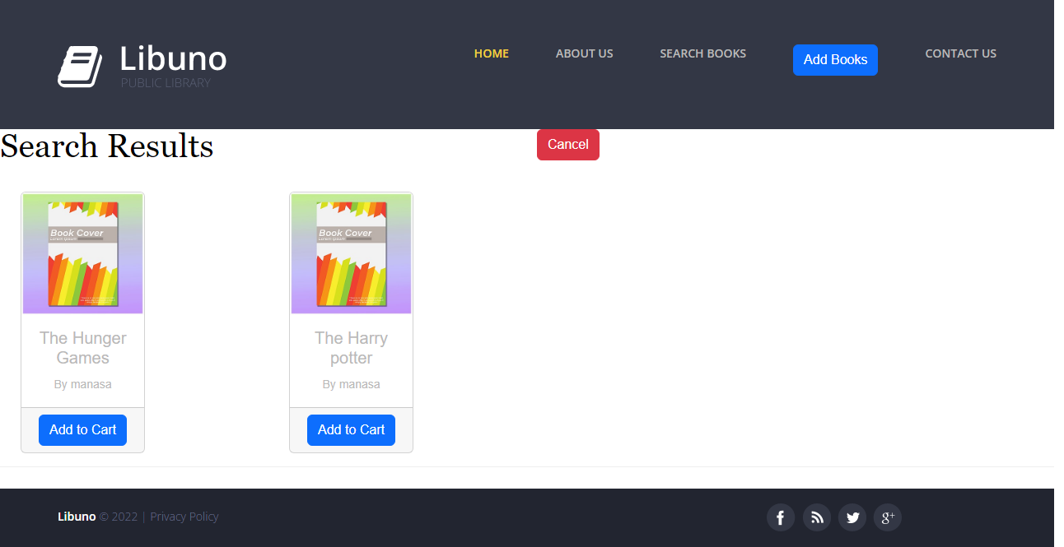
Search results

Slide 19
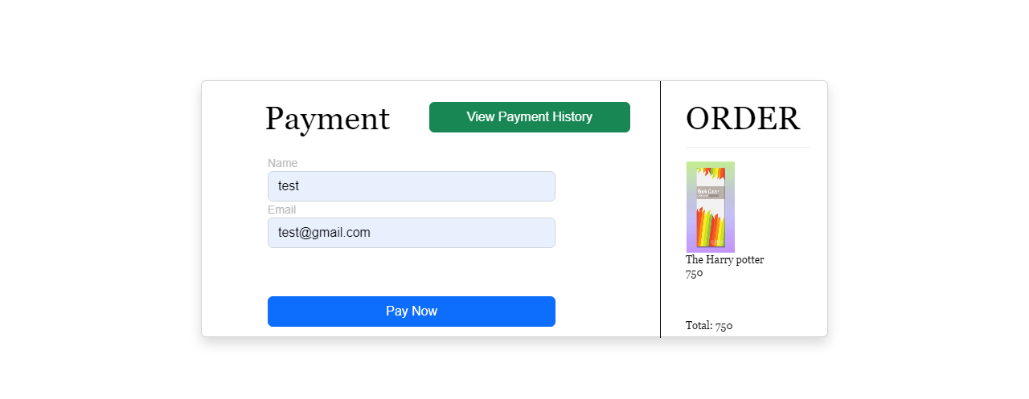
Payments

Slide 20
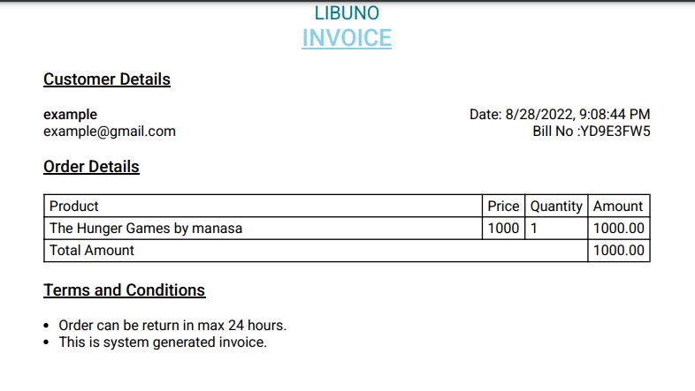
Invoice

Slide 21
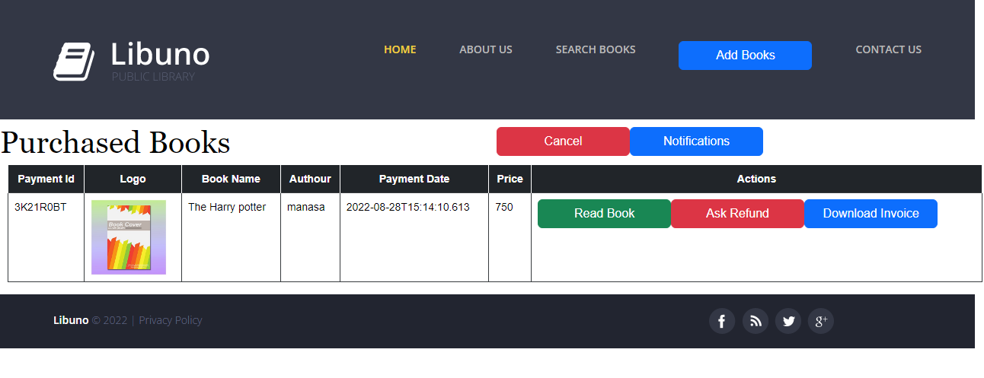
Purchased Books

Slide 22
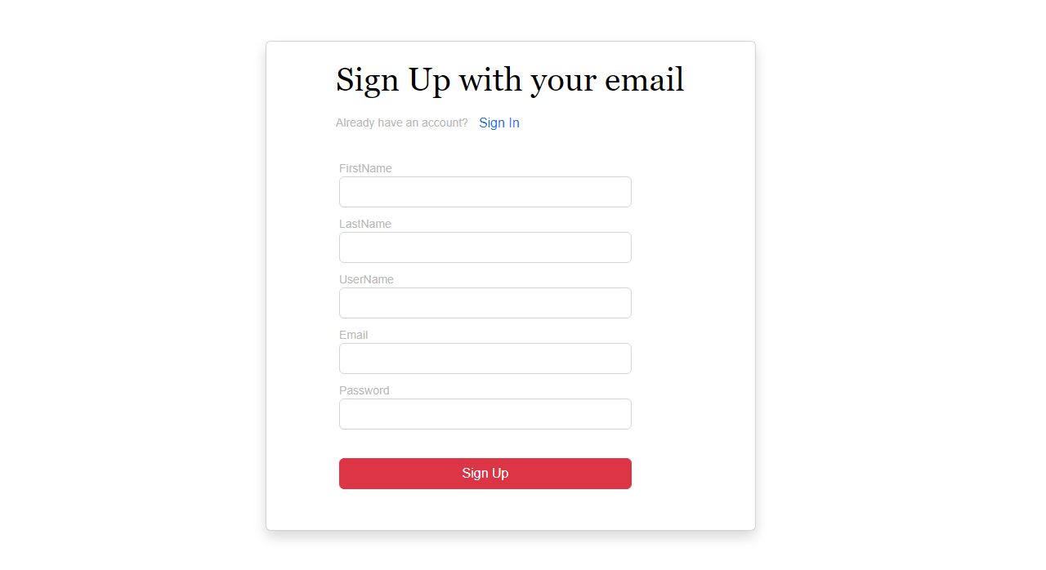
Author Signup

Slide 23
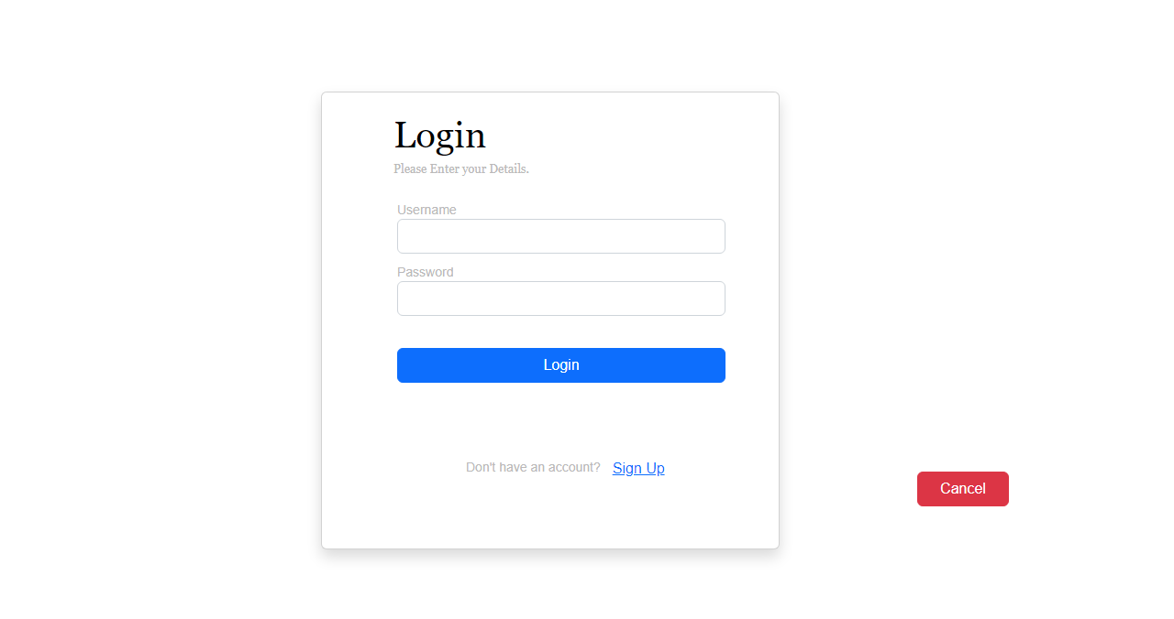
Author Login

Slide 24
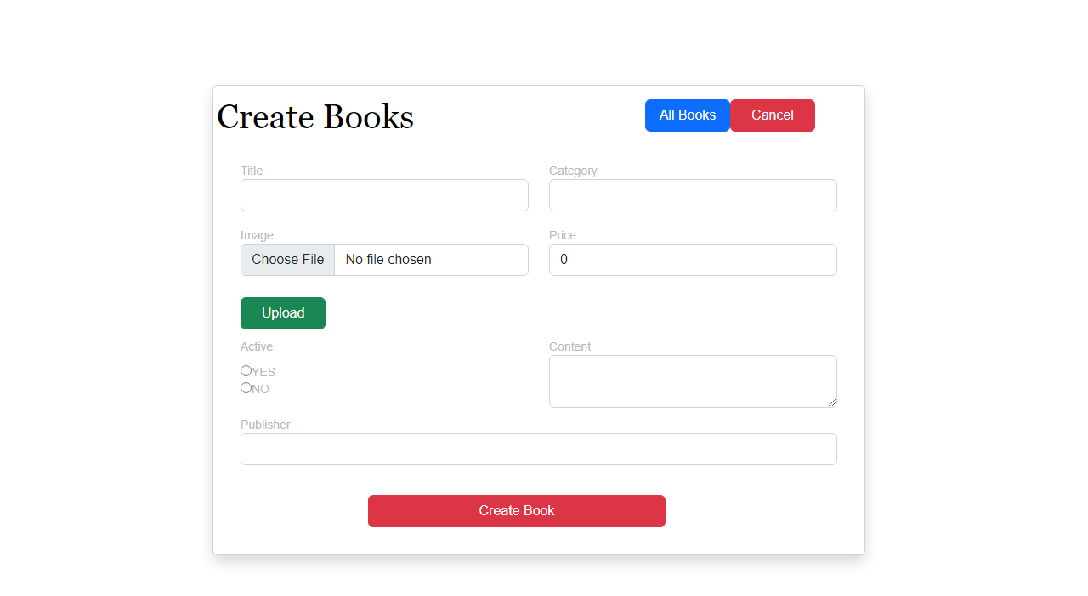
Create Books

Slide 25
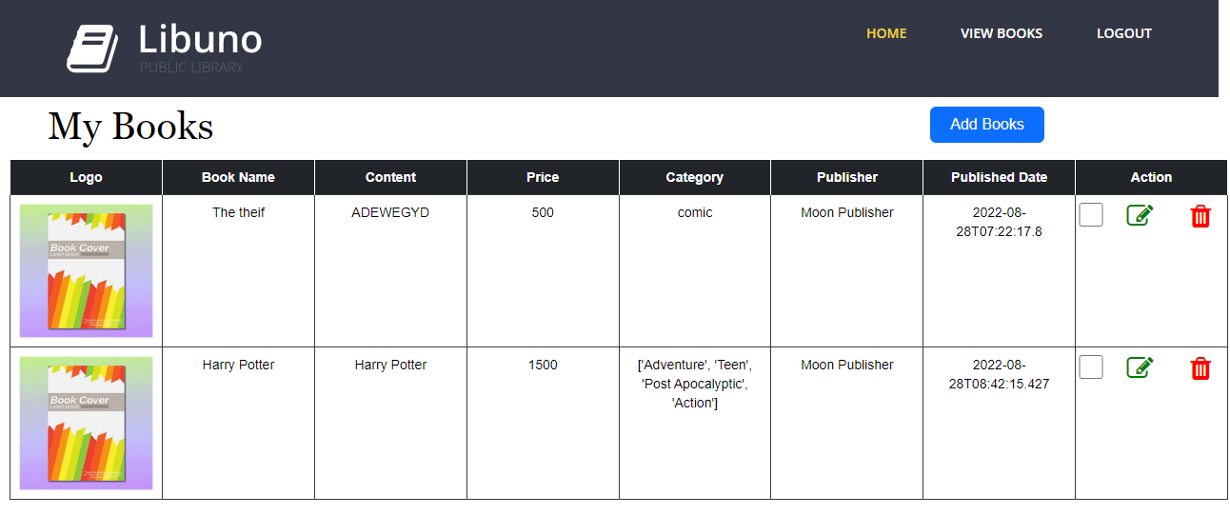
My Books

Slide 26
THANK YOU

